Slide 1


Devils among Apocalypse
SER594 GAME PROGRAMMING AND DESIGN

Slide 2
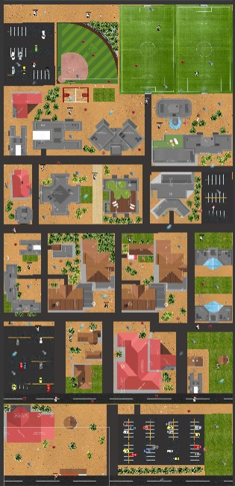
OVERVIEW
BATTLEGROUND – The ASU Polytechnic Campus
Single player game
Player can grab food items, goodies, rewards
Receives points by defeating the opponent
Wins the game by surviving or defeating all the monsters

Slide 3
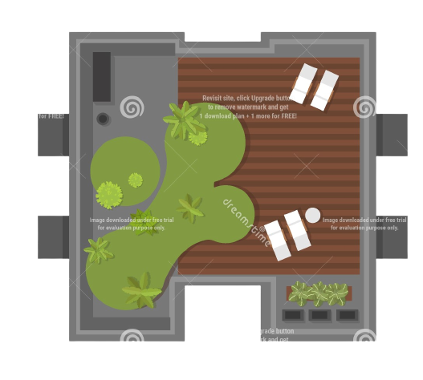
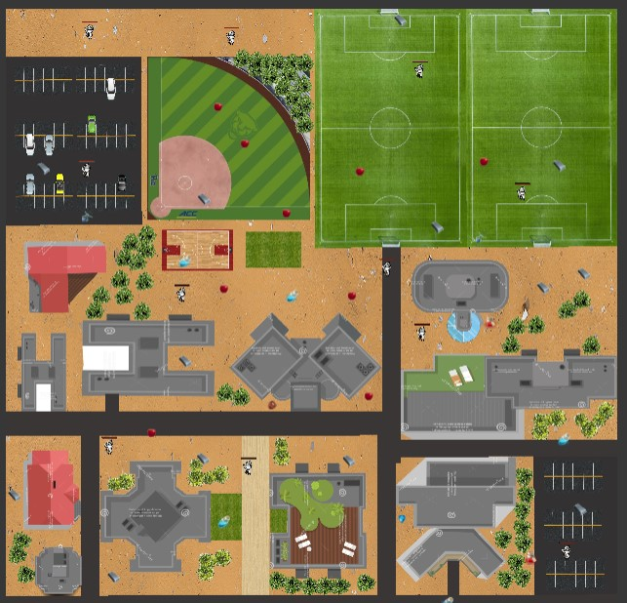
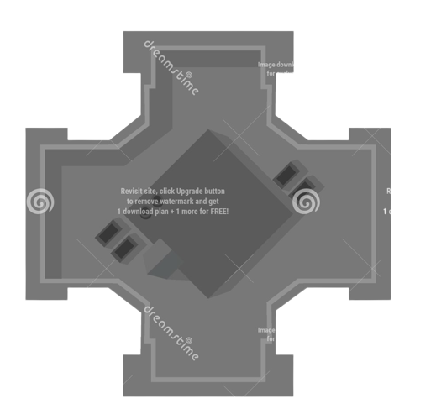
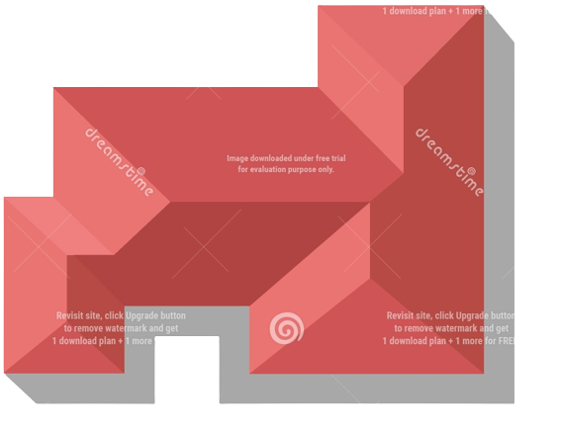
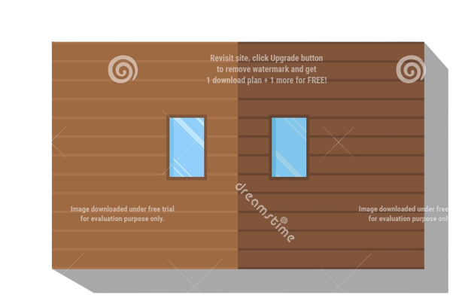
GAME DESIGN

Slide 4
GAME PLAY
The student is stuck at the poly campus among an apocalypse trying to survive among enemies and dire situations.
The players can use weapon, move around the campus and kill enemies.
Entire poly campus is exactly represented in the form of a map and the student is able to move through this.
During the gameplay the sun devil gets to collect various rewards.
Player can also interact with other fellow characters.

Slide 5
FEATURES
Loading different scenes, scene management
Realistic and exact map of the Poly campus.
Inventory System
Melee Combat System
Health System
Main Menu, Game Over Menu and Pause Menu
Pause, Menu, Quit, Resume options in the menus
Conversation and Dialogue System

Slide 6
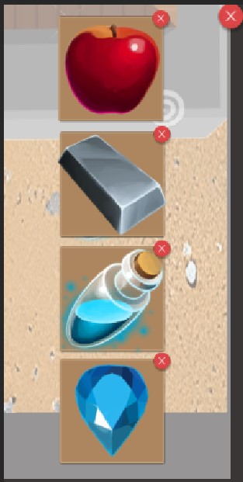
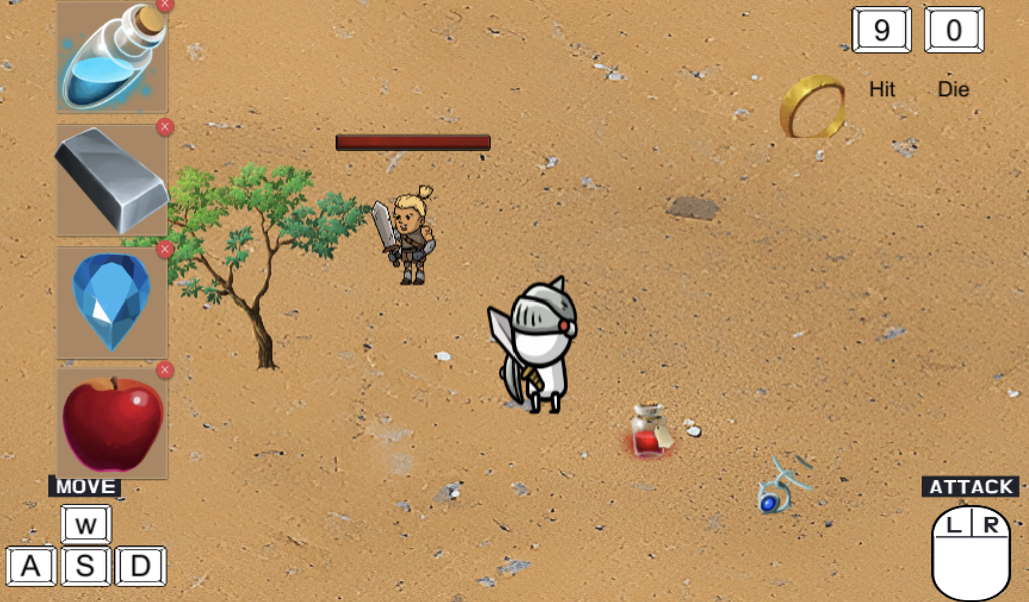
INVENTORY

Slide 7
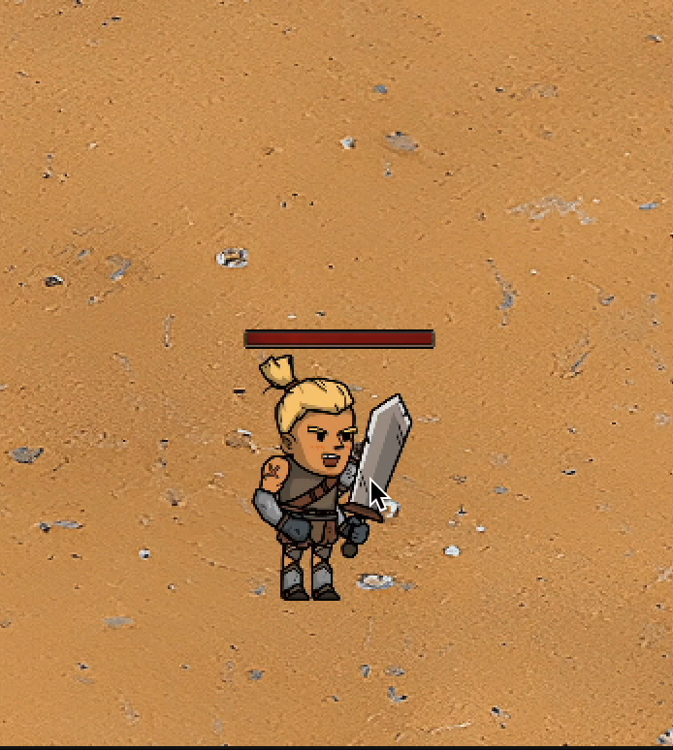
COMBAT

Slide 8
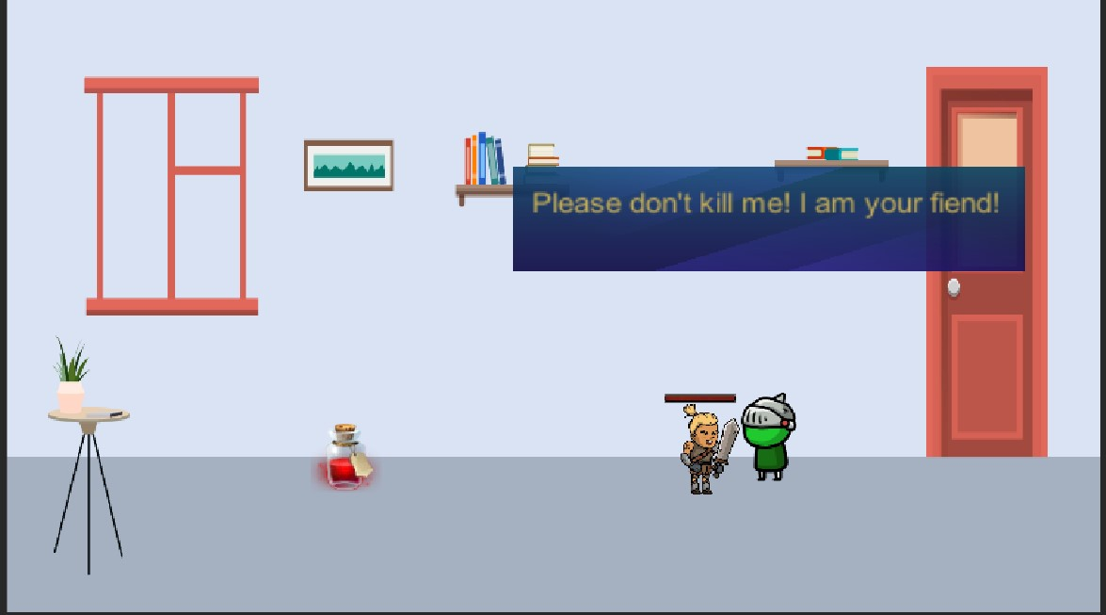
CONVERSATION

Slide 9
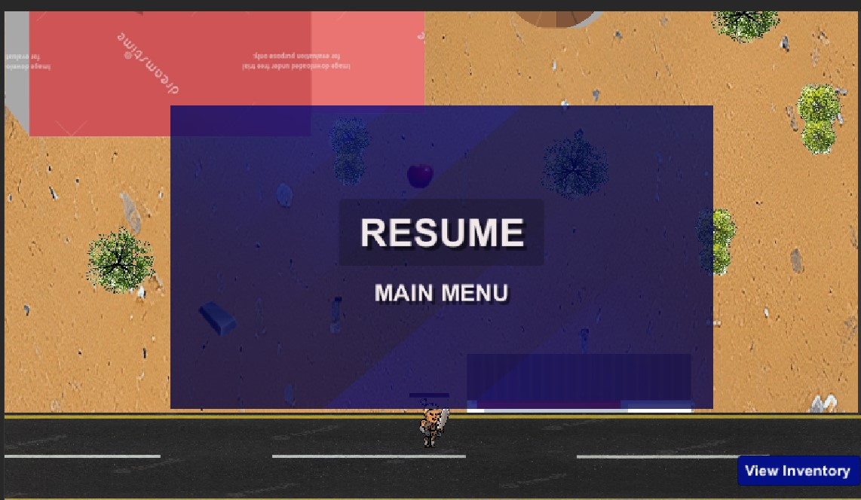
PAUSE MENU IN GAME

Slide 10
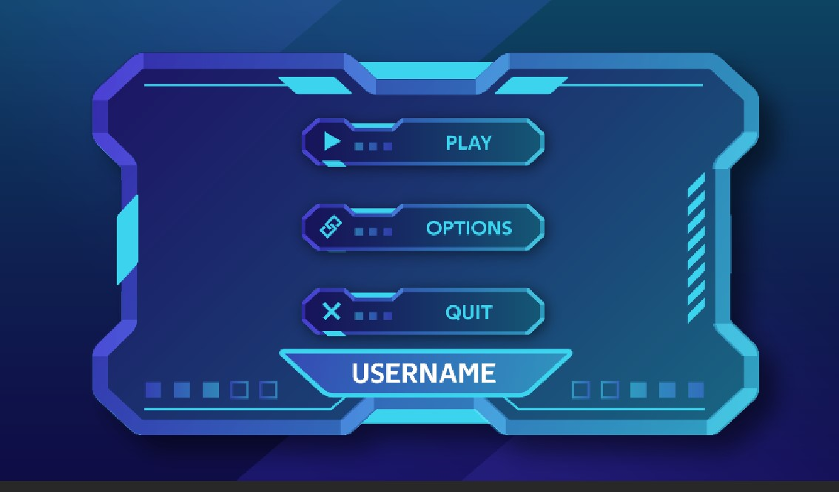
GAME MENU

Slide 11

GAME OVER SCREEN

Slide 12
GROUP MEMBERS
Keya Patel (1226211573)
Aakanksha Desai (1226102074)
Alok Rajpurohit (1225311776)
Dhwanil Vashi (1226280551)

Slide 13
THANK YOU

